Slide 1


Green Pace
Security Policy Presentation
Developer: Unique Chambers

Slide 2

OVERVIEW: DEFENSE IN DEPTH
The model DiD shows the multiple layers of security that should used in order to protect businesses from attacks. We are able to see the policies, the focus, and critical assets systems and data.

Slide 3
THREATS MATRIX
The Threat Matrix is a helpful visual tool to identify business risks, threats and vulnerabilities as part of a risk management program.
Likely Data Type Data Value String Correctness SQL Injection Memory Protection Polymorphic Object | Priority Data Type Data Value String Correctness SQL Injection Memory Protection Expressions
Low priority Assertions Exceptions Polymorphic Object Integer Precision | Unlikely Assertions Integer Precision

Slide 4
10 PRINCIPLES
Validate Input Data
Heed Compiler Warnings
Architect and Design for Security Policies
Keep It Simple
Default Deny
Adhere to the Principle of Least Privilege
Sanitize Data Sent to Other Systems
Practice Defense in Depth
Use Effective Quality Assurance Techniques
Adopt a Secure Coding Standard

Slide 5
CODING STANDARDS
Standards | Rule | Severity | Likelihood | Remediation Cost | Priority | Level
Data Type | STD-001-CPP | High | Likely | High | P9 | L2
Data Value | [STD-002-CPP] | High | Likely | High | P9 | L2
String Correctness | [STD-003-CPP] | High | Likely | Medium | P18 | L1
SQL Injection | [STD-004-CPP] | High | Likely | Medium | P18 | L1
Memory Protection | [STD-005-CPP] | High | Likely | Medium | P18 | L1
Assertions | [STD-006-CPP] | Low | Unlikely | High | P1 | L3
Exceptions | [STD-007-CPP] | Low | Probable | Medium | P4 | L3
Expressions | [STD-008-CPP] | High | Probable | Medium | P4 | L3
Polymorphic Object | [STD-009-CPP] | Low | Likely | Low | P2 | L2
Integer Precision | [STD-010-CPP] | Low | Unlikely | Medium | P2 | L3

Slide 6
ENCRYPTION POLICIES
Encryption in rest - We shall encrypt data at rest using full-disk encryption at the server level, as well as database encryption using MySQL Server, and provide a backup strategy.
Encryption at flight - Use up to date, secure libraries, use Public Key infrastructure for end-to-end protection on message bodies or attachments, use Managed File Transfer or SSH with expiration date on the link, password access, utilize Data leak prevention mechanisms built into cloud services.
Encryption in use - Utilize identity management mechanisms to confirm user roles and identity, allow conditional access to the tools functionality based on the user roles and other parameters. Use IRM digital rights management, to apply persistent protection to documentation.

Slide 7
TRIPLE-A POLICIES
Authentication - Process of identifying a user, using valid credentials of user and password. Control how a user is authenticated using a secured local database or external AWS server, prefer to use tried and trusted protocol.
Authorization - After the user has been authenticated, authorization shall be used to determine which resources and functionality the user is allowed to access and which operations can be performed.
Accounting - Monitor and log any user events while they are logging in/out or utilizing the resources, as well as user uptime or any other configured parameter.

Slide 8
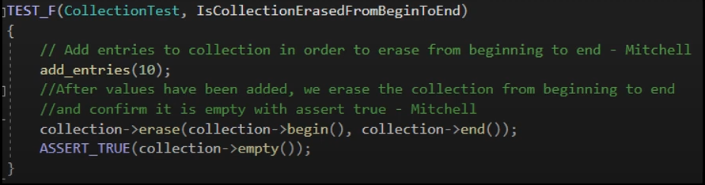
Unit Testing
The unit testing below is looking at Assertions, mainly used in unit testing and how these assertions can be helpful in both testing and ensuring proper data is being used in other applications. Standard coding label is [STD-006-CPP].

Slide 9
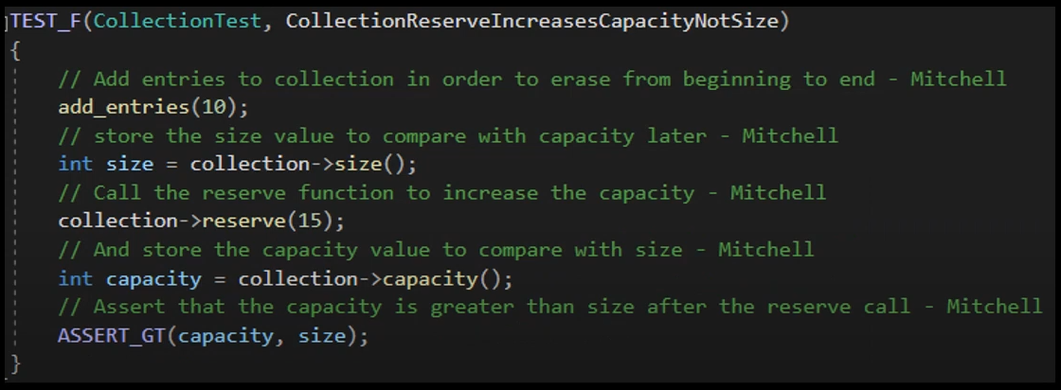
Unit Testing

Slide 10
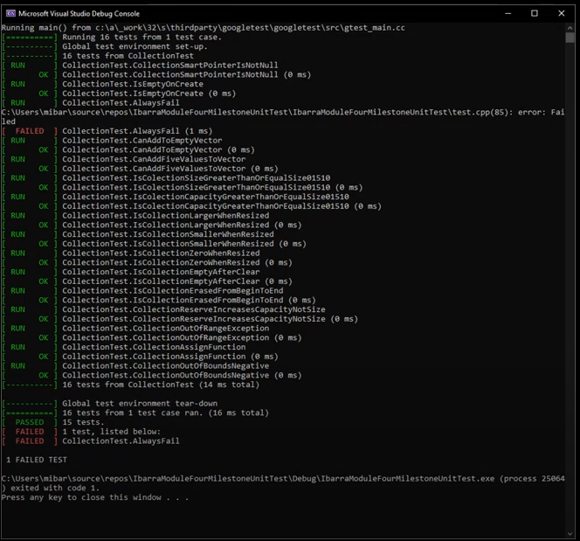
Unit testing -
Unit test is a way of testing a unit - the smallest piece of code that can be logically isolated in a system. In most programming languages, that is a function, a subroutine, a method or property.

Slide 11

AUTOMATION SUMMARY

Slide 12
TOOLS
Every software development approach has a pipeline or a series of steps the software goes through during its lifecycle. DevSecOps's steps and stages are mostly automated, prioritize security, and depend upon collaboration between teams.
Parasoft C/C++test - Used during the design, verify/test stage in pre-production. Used during the transition/health check and maintain and stabilize stage in post-production.
Intruder - Used during transition and health check stage of post-production to perform penetration tests.
LoadNinja - Used in the verify and test pre-production for stress testing. Used during the maintain and stabilize in post-production.

Slide 13
RISKS AND BENEFITS
Benefits
The benefits are you can save the company it’s reputation. You can save the company money and time. And increase security of the business.
It will satisfy many compliance standards for industries like financial services and life sciences.
Risks
The risks are constant updates to ensure that no threats can get through defense. Hackers are always using different methods to hack.
It’s always a possibility that it’s can be a human error, by opening an email that is infected.

Slide 14
RECOMMENDATIONS
Assess your current policies and compare them to the best practices and requirements in your industry and jurisdiction. The assessment should cover the scope, content, format, and communication of your policies, as well as the alignment with business objectives and risk appetite.
Identify the gaps between current policies and the desired state. A gap can be a missing policy, an outdated policy, a conflicting policy, or a poorly implemented policy.
Communicate and train staff on the new or updated policies and their implications. We should use various channels and formats, such as emails, newsletters, intranet, webinars, or workshops, to disseminate your policies and raise awareness among employees. You should also provide training and education programs to help staff understand and apply the policies in their daily work

Slide 15
CONCLUSIONS
In conclusion we should always step two steps ahead of hackers, which means we should be vigilant in upgrading policies and constant monitoring of database.
We should be diligent in training staff concerning new policies and what to look out for when receiving a phishing email.
Follow and review defense in depth strategies and understand the security policy.

Slide 16
REFERENCES
C++test - Check C++ and C Code for Compliance. Parasoft. (2021, June 7). https://www.parasoft.com/products/parasoft-c-ctest
Create and Run Load Tests in Half the Time. LoadNinja. (https://loadninja.com
Log Management & Analysis Software Made Easy. Logentries. (n.d.). https://logentries.com
Tasnim, R. (n.d.). What Is Unit Testing? Softwaretestingstuff. Retrieved February 25, 2024, from https://www.softwaretestingstuff.com/c-unit-testing

